Slide 1
Student Management System
NAME : BALASUBRAMANIAN
INSTITUTE : BESANT TECHNOLOGIES

Slide 2
Purpose:
Project Overview
This project is a student registration system where users can sign up, log in, and manage student details.
Technologies Used :
HTML5 – Structure of the web pages.
CSS – Styling and layout, using Bootstrap for responsive design.
JavaScript – For form validation and local storage management.
Bootstrap – For quick styling and responsive design.
pages :
Sign Up Page: Users can register with a username, email, and password.
Login Page: Users log in using their credentials and access the form page.
Form Page: After login, users can fill in student information.
Manage Students: Admins (post-login) can view or manage student records.

Slide 3
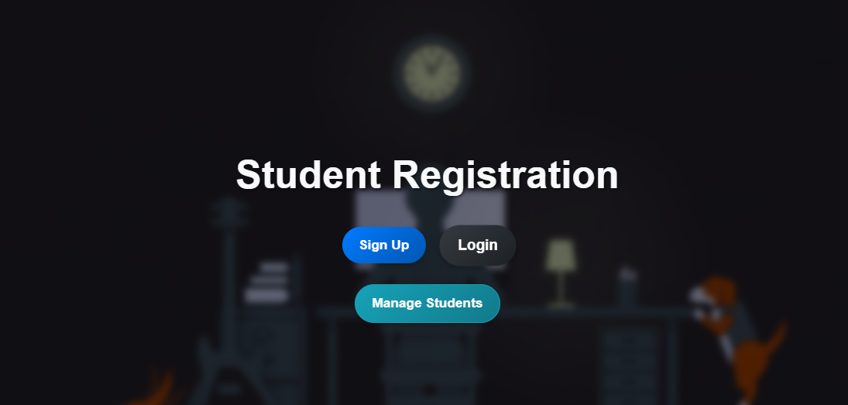
Home Page :
Description: This is the first page users see when visiting the website.
The page contains:
Sign Up button: Takes the user to the Sign Up page.
Login button: Takes the user to the Login page.
Manage Students button: Redirects the user to the login page if they aren't logged in yet.
.

Slide 4
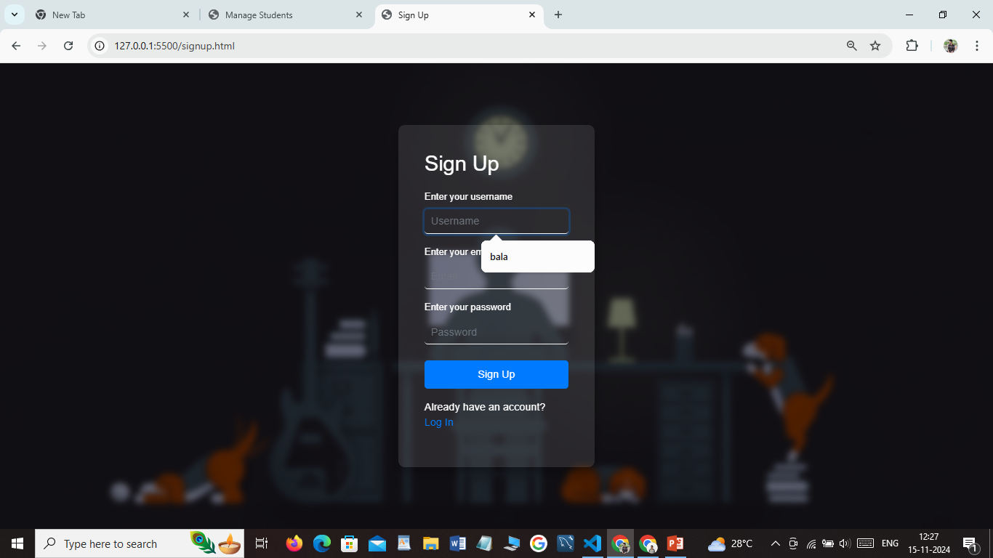
Sign Up Page :
Description: This page allows users to register by entering their username, email, and password. On successful registration, the data is stored in LocalStorage.
Input fields: Username, email, password.

Slide 5
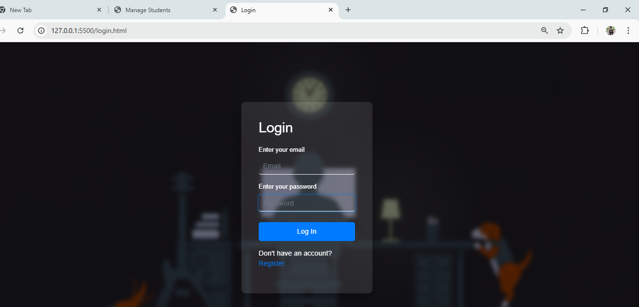
Login Page :
Description: Users log in here with their email and password. If credentials match the stored data, the user is redirected to the Form page.
Input fields: Email and password.

Slide 6
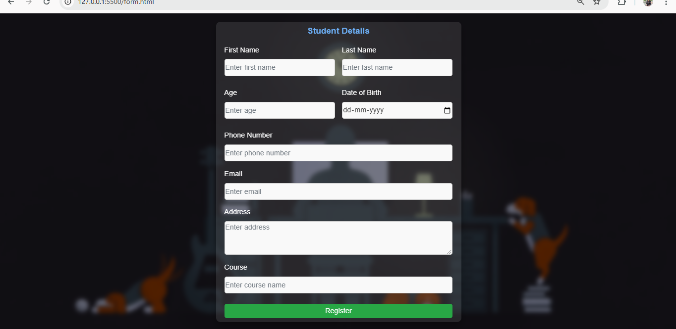
Form Page :
Description: This page allows the user to fill in student details (such as name, age, etc.). The information is stored in LocalStorage.
Users can enter student data and submit it.
The data gets saved to LocalStorage and can be viewed or updated later.

Slide 7
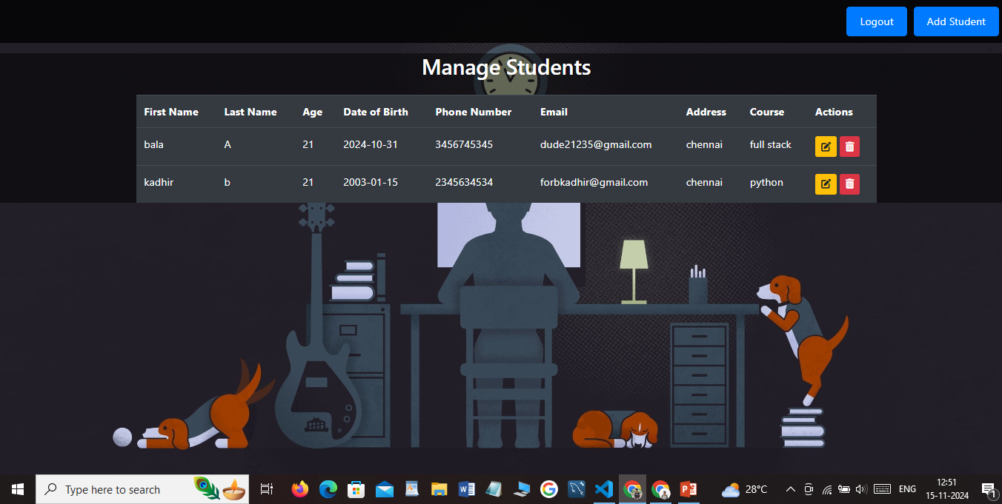
Manage Students Page :
Description: The Manage Students page is accessible after login,
where users (admin) can view and manage student data.
Users can:
View student records stored in LocalStorage.
Update or delete records if needed.

Slide 8
Project Workflow:
Content:
Step-by-step user journey:
User visits Home Page and either signs up or logs in.
After signing up, the user is redirected to the Login Page.
Upon logging in with correct credentials, the user accesses the Form Page.
On the Manage Students Page, the user can manage student data.

Slide 9
Thank You

